Slide 1
Data Science Behind Speech Recognition
Lucy ADEKE
MoTIS 8
02nd/03/2018

Slide 2
What is this all about?
Data is used to train speech recognition systems
Consists of Acoustic model and Language model
Sounds → Words → Sentences
Use neural networks
Deep Learning techniques enabled the use of speech recognition outside controlled environments
Error rates of less than 8% reported (2017)

Slide 3
History of speech recognition
1950s - 9 numbers
1960s - 16 English words
1970s - Interprete multiple voices
1980s - Prediction comes into play
1990s - First commercial text to speech tool
2000s - Google revolutionizes it

Slide 4




Common users of this technology?

Slide 5


Uses of speech recognition
control smart phones (voice dialling, voice search)
automatically handle input as part of help desk applications
assist people with disabilities
Call routing
speech to text processing

Slide 6
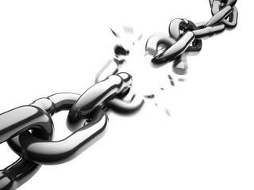
Shortcomings
Background noise interference
Limited Language Support
Variation of pronunciation due to various accents

Slide 7

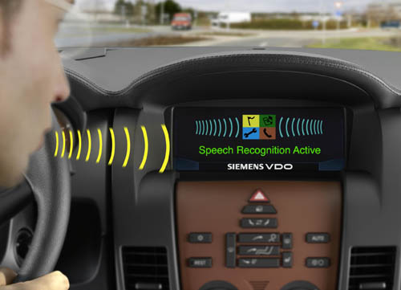
What’s the future?
Replace GUIs in businesses
Connected Homes
Car Systems
Audio and Video entertainment systems
Authentication

Slide 8
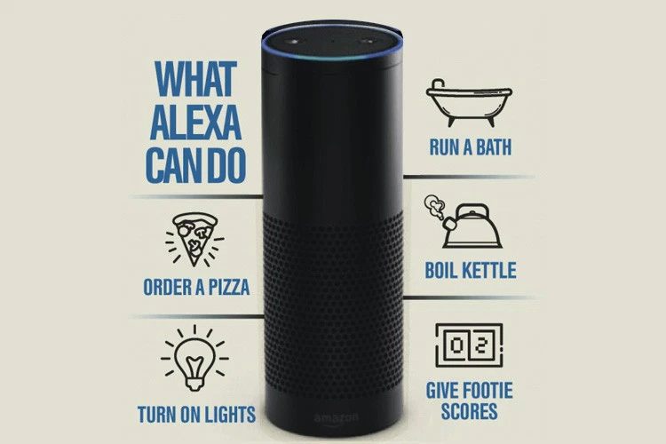

Slide 9

Threats
Privacy
Human interaction will become obsolete
Loss of jobs

